Slide 1
What is evolutionary ecology?

Slide 2
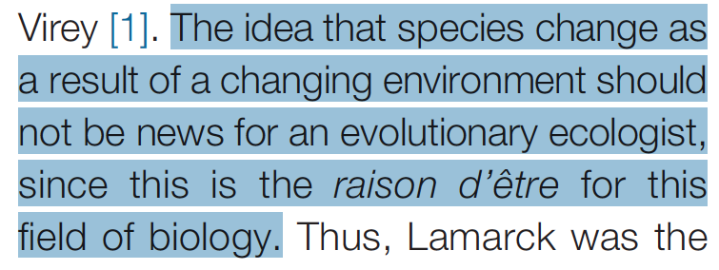
Bjorklund 2019. Trends in Ecology and Evolution

Slide 3
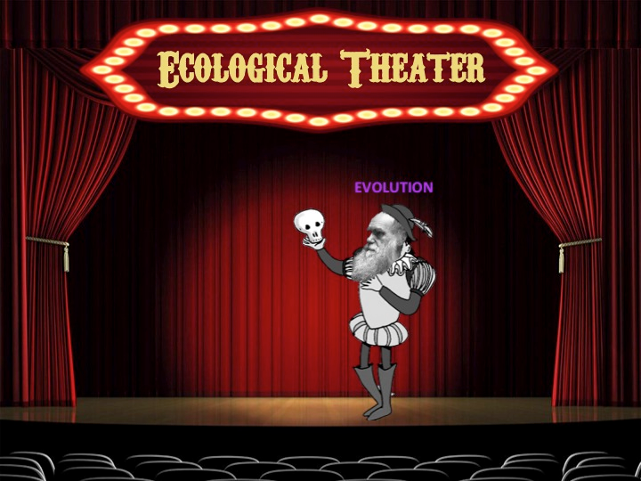
Cartoons by E. Holdridge
http://www.ecoevolab.com/cartoon-the-classics-1/
Notes:
Hutchinson (1965) describes ecology as the backdrop against which evolutionary processes play out. In this analogy, ecology can affect evolution, much like the setting of a play can influence the audience’s perception. However, evolution (the “play”) as no affect on ecology (the “theater”).

Slide 4
Evolutionary ecology. “Evolutionary biologists emphasize historical and lineage-dependent processes and hence often incorporate phylogenetic reconstructions and genetic models in their analyses. Ecologists, while cognizant of historical processes, tend to explain variation in terms of the contemporary effects of biotic and abiotic environmental factors. Evolutionary ecology spans these two disciplines and incorporates the full range of techniques and approaches from both.”
Fox, CW et al. 2001. Evolutionary ecology: concepts and case studies.

Slide 5
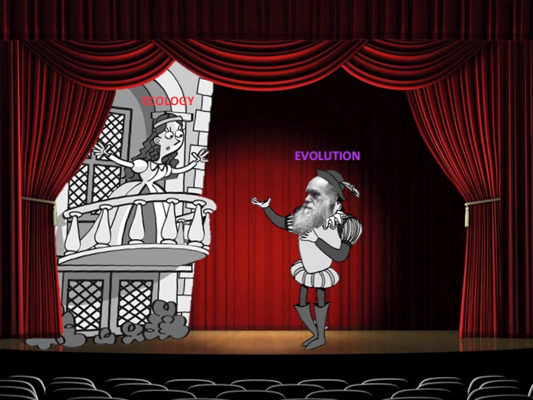
Cartoons by E. Holdridge
http://www.ecoevolab.com/cartoon-the-classics-1/
Notes:
“Animal Population Regulation by the Genetic Feed-back Mechanism” (D. Pimentel 1961 Am Nat) To stick with this analogy, Pimentel (1961) sees ecology and evolution more as two actors in the same play, interacting dynamically.
*The contrast of these two approaches to evolutionary ecology is laid out wonderfully in Reznick 2013 Am Nat.
**Cartoons by E. Holdridge. http://www.ecoevolab.com/cartoon-the-classics-1/

Slide 6
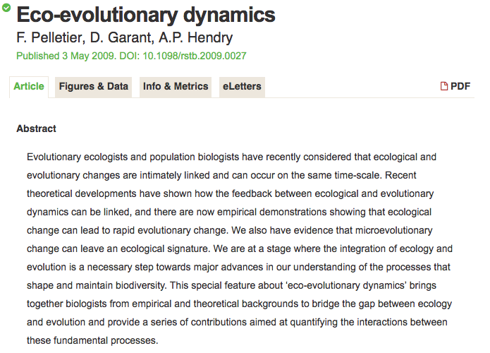

Slide 7
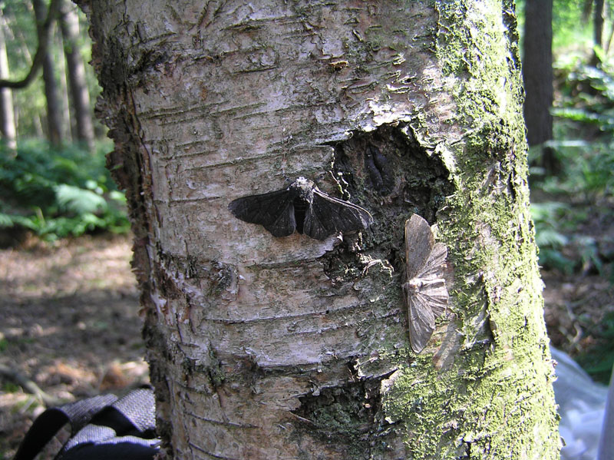
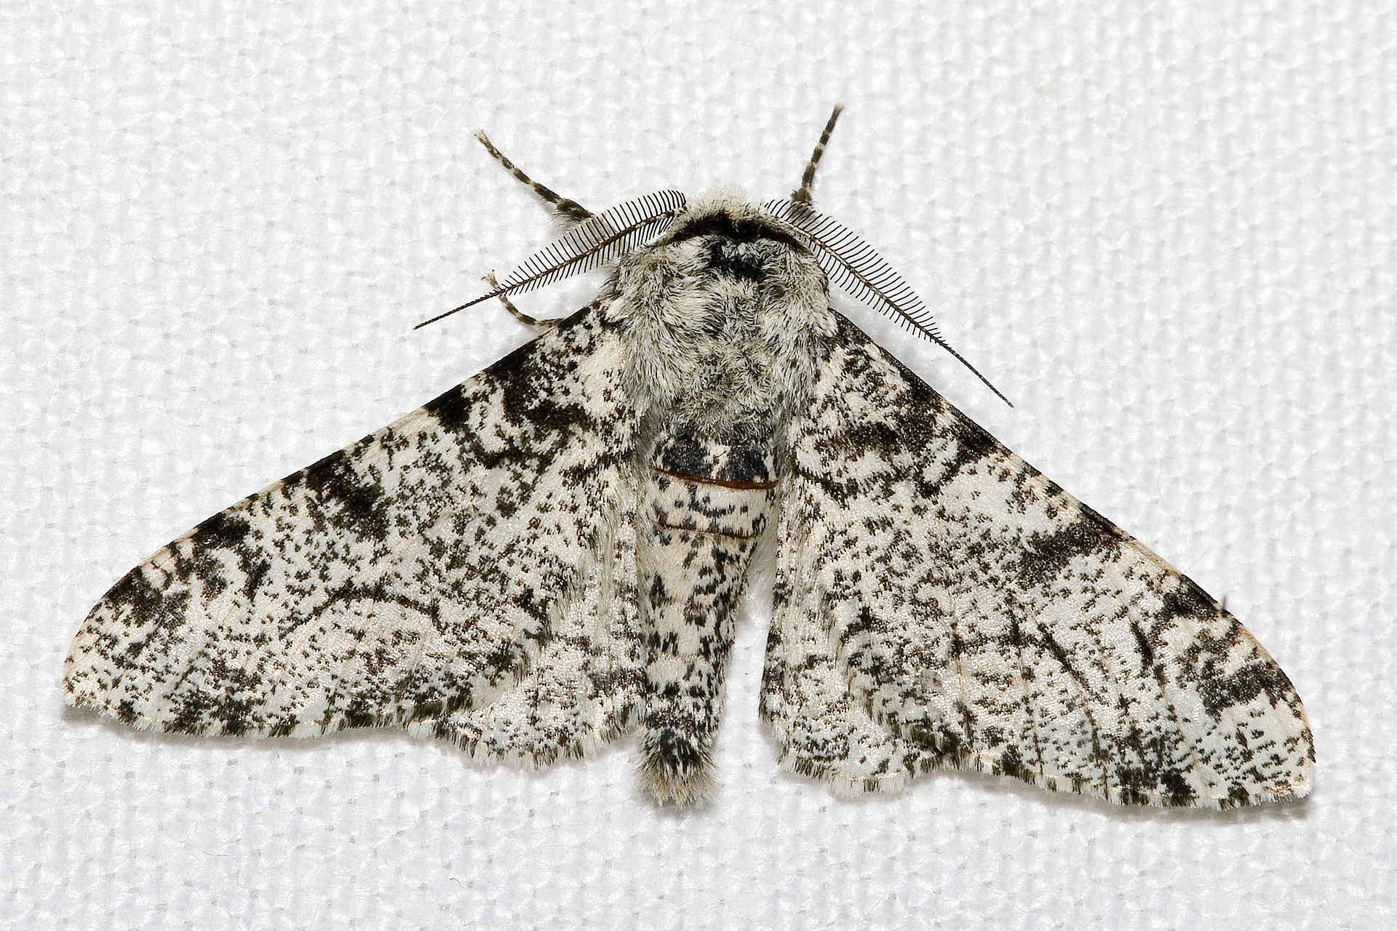
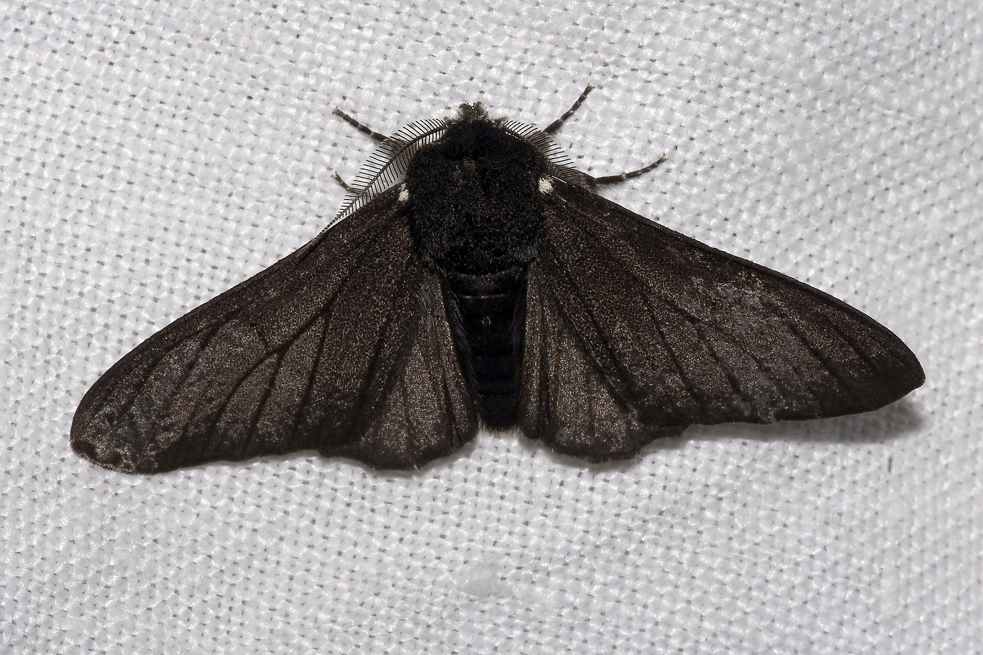
Pelletier et al. (2009) Eco-Evolutionary dynamics. Phil Trans Roy Soc Lond
Eco to Evo (Ecology affects evolution)
White-bodied peppered moth
Photo credit: Olaf Leilllinger
Black-bodied peppered moth
Photo credit: Maarten Saane
Both colour variants on the same ‘clean’ tree
Photo credit: Olaf Leilllinger
Notes:
Industrial melanism in peppered moths. The dark variant was first observed in 1848. Eventually, the dark form constituted >90% of the population in heavily polluted areas.

Slide 8
Eco to Evo
How a species interacts with its environment, the species’ ecology, determines its population dynamics
If the trait of interest is heritable and the number of individuals with one trait variant is changing relative to another, evolution occurs

Slide 9
Evo to Eco
If the number of white-bodied variants decreases relative to black, and body color is heritable then evolution occurs. But also, if the number of white-bodied variants decreases, then any of the following ecological effects may occur:
Decrease in predators due to a reduced prey source
Release from intraspecific competition for other variants
Release from interspecific competition for other competitors

Slide 10
Evo to Eco
“At every moment natural selection is operating to change the genetic composition of populations in response to the momentary environment, but as that composition changes it forces a concomitant change in the environment itself. Thus organisms and environments are both causes and effects in a coevolutionary process.”
Lewontin, R. 2000. The triple helix. Gene, organisms, and environment. p126.

Slide 11
Evo to Eco
Natural selection on traits that affects survival or reproduction will leave a population dynamical signature
Pelletier et al. (2009) Eco-Evolutionary dynamics. Phil Trans Roy Soc Lond
Number of clones (genetic composition) affects population dynamics
Yoshida et al. 2013. Rapid evolution drive ecological dynamics in a predator-prey system. Nature.
Traits that affect dispersal will change the distribution of individuals
Pelletier et al. (2009) Eco-Evolutionary dynamics. Phil Trans Roy Soc Lond
Notes:
Coupling in metapopulations, dispersal in heterogeneous environments.

Slide 12
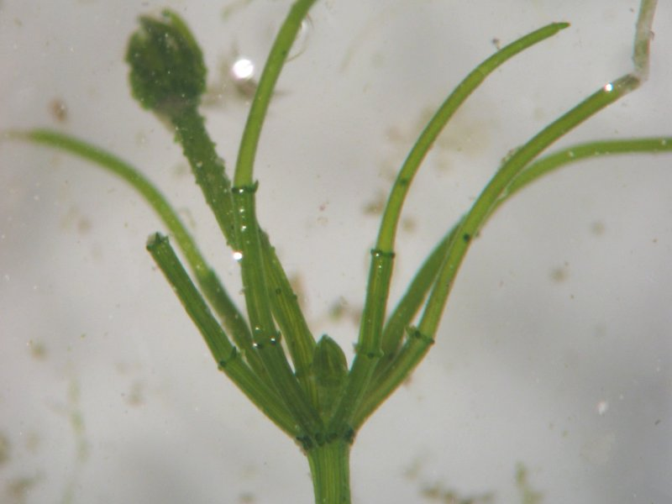
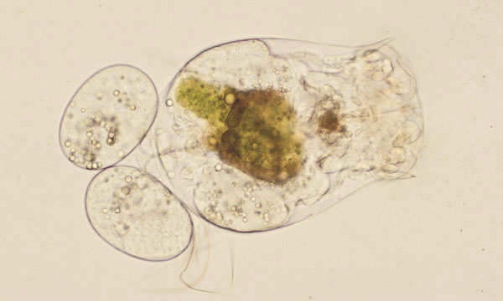
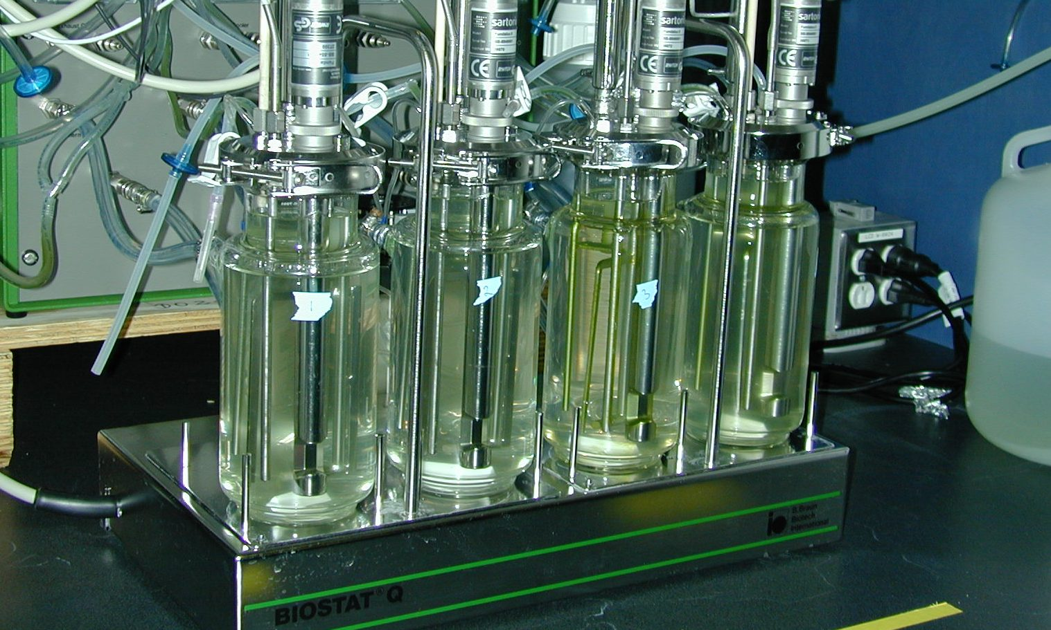
Yoshida et al. 2013. Rapid evolution drive ecological dynamics in a predator-prey system. Nature.
Photo credit: Gregor Fussmann
Photo credit: Kristian Peters
Photo credit: Gregor Fussmann
Notes:
Rotifers, algae.

Slide 13
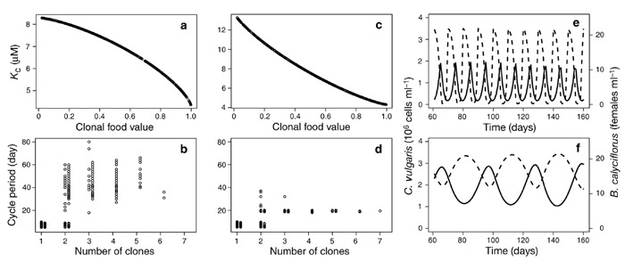
Yoshida et al. 2013. Rapid evolution drive ecological dynamics in a predator-prey system. Nature.
Theory
Trade off 1
Trade off 2
Single clone = short cycles
Competitive ability
Multiple clone = long cycles
Notes:
a, c, Modelled tradeoff curves between algal food value and competitive ability (represented by the half-saturation constant, K_{c}, for nutrient uptake by algae), with α′ >1 (a) and α′ <1 (c). b, d, Effects of clonal diversity on predator–prey cycle length for the two tradeoff curves between algal food value and competitive ability, with α′ >1 (b) and α′ <1 (d). Cycle periods in b and d are the result of 700 simulation runs each for one, two, three, five or seven clones present at the start of the run. Cycle periods are plotted against the number of clones remaining after running the model long enough for competitively inferior clones to be eliminated. ‘Degenerate’ cases (in which some of the initially present clones were eliminated) are plotted just to the right of non-degenerate cases in b and d. e, f, Cycles predicted by the model for the Brachionus predator (solid line) and Chlorella prey (dashed line) in a single-clone system (e) and a multiple-clone system (f). Model equations and further technical details are given in the Supplementary Information.

Slide 14
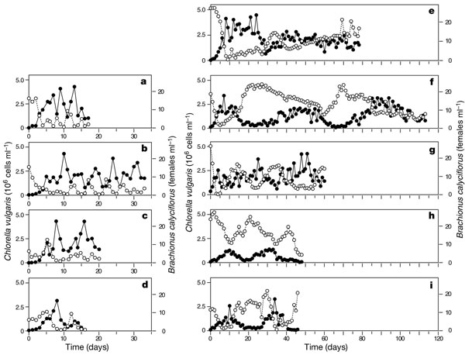
Yoshida et al. 2013. Rapid evolution drive ecological dynamics in a predator-prey system. Nature.
Multiple clones = long cycles
Experiment
Single clone = short cycles
prey
predator
Notes:
a–d, Single-clone algal populations; e–i, multiple-clone algal populations. Filled circles, B. calyciflorus (predator); open circles, C. vulgaris (prey). In a–d there are short-period predator–prey cycles with the classical phase relations; in e–i there are long cycles with predator and prey oscillations nearly out of phase with each other. Dilution rates, δ (d⁻¹) a, 0.57; b, 0.65; c, 0.67; d, 0.68; e, 0.72; f, 0.64; g, 0.69; h, 0.95; i, 1.00. Data for four (f–i) of the five multiple-clone trials were obtained from ref. 13. The fifth trial is a new experiment, conducted in parallel with the single-clone trials, to verify that the lapse of time did not result in any change of our rotifer or algal stock cultures that would change the qualitative dynamics of a system with multiple algal clones. Note that population cycles at relatively high dilution rates (h, i) were also long and with out-of-phase relations, as our mathematical model predicts.

Slide 15
Summary
What are eco-evolutionary dynamics
Explain/give an example of how ecology affects evolution
Explain/give an example of how evolution affects ecology

